Slide 1
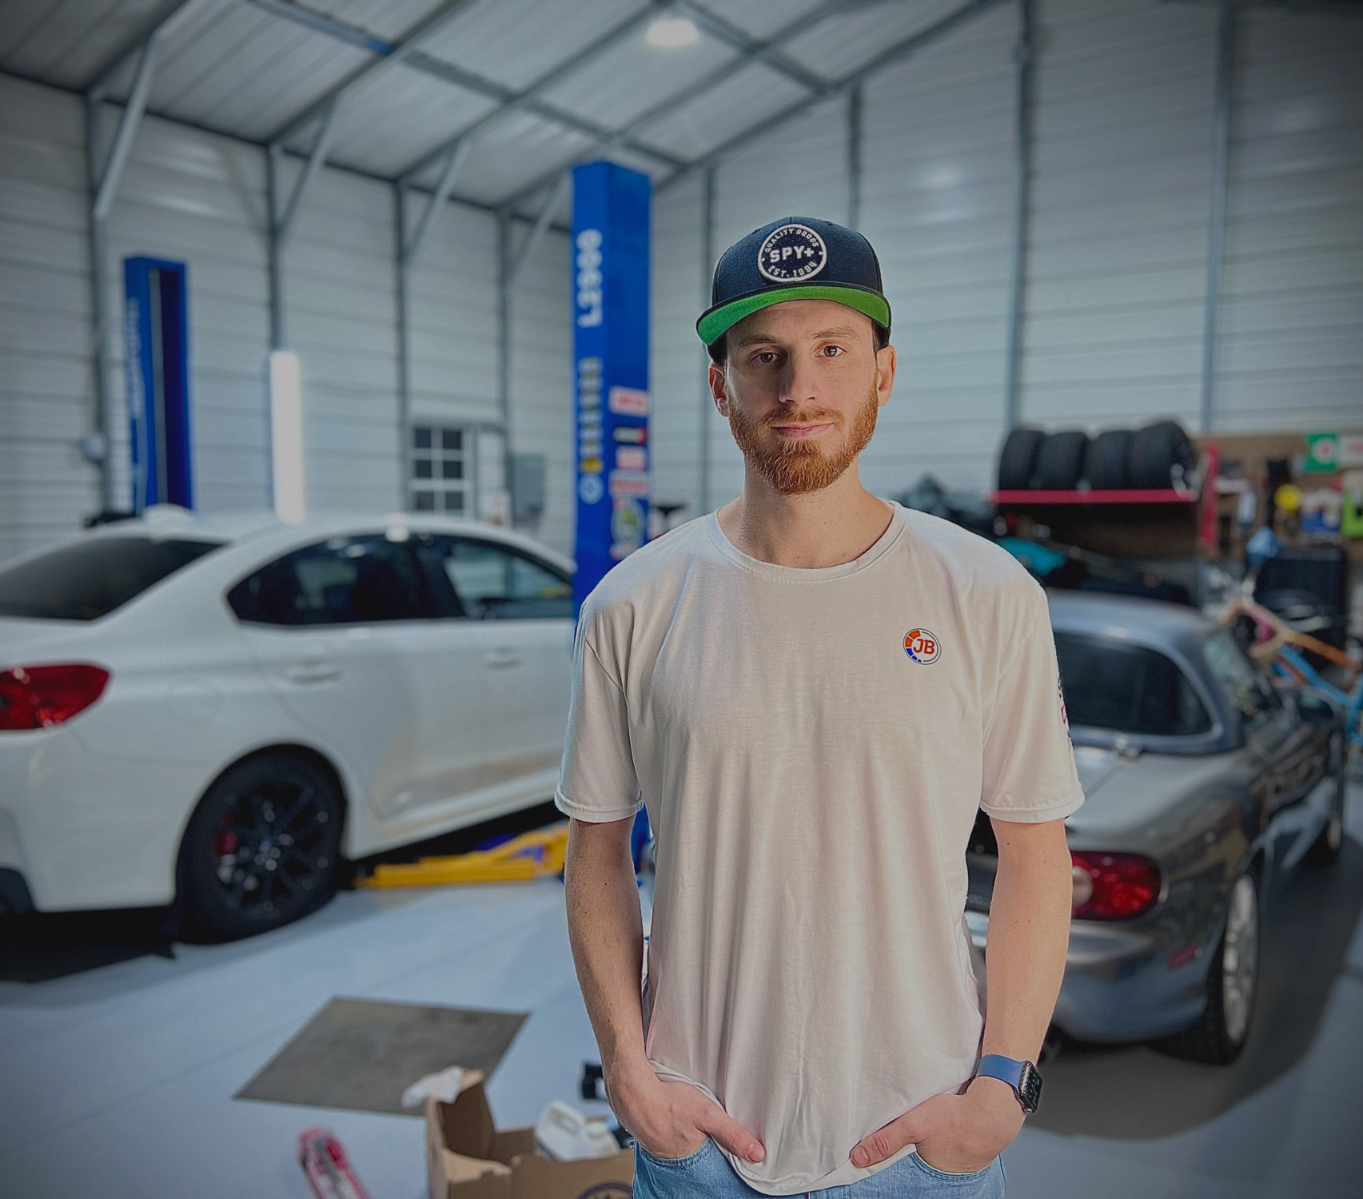
About Me
I am a highly motivated designer and developer currently located in Wilmington, North Carolina with over four years of experience designing and building websites, logos, and much more. I have worked for companies with different backgrounds – from a mobile app startup, to a brewery, to an established e-commerce company.
Since 2017, I have completed Udacity’s Front End Web Development, Udacity’s React Developer, and Udacity’s UX Designer Nanodegree programs. These programs have helped me learn how to not only design great user interfaces, but how to build them too!
See my full online portfolio here

Slide 2
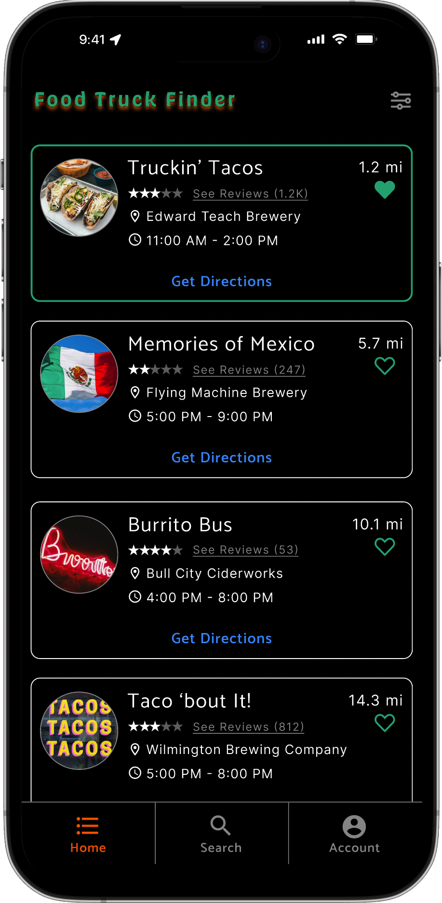
Food Truck Finder
A mobile app to find your next food truck meal.
Jeff Berlin
November 2022 – January 2023
Figma, Zeplin, Miro, Lookback

Slide 3

Challenges
When designing the prototype, the main goal was to make it as easy as possible for users to use and navigate. During the usability study, I quickly noticed that closing the Filters overlay was overly complicated for the users and needed attention. Every user tried swiping down several time, instead of clicking outside of the overlay to close it.

Slide 4
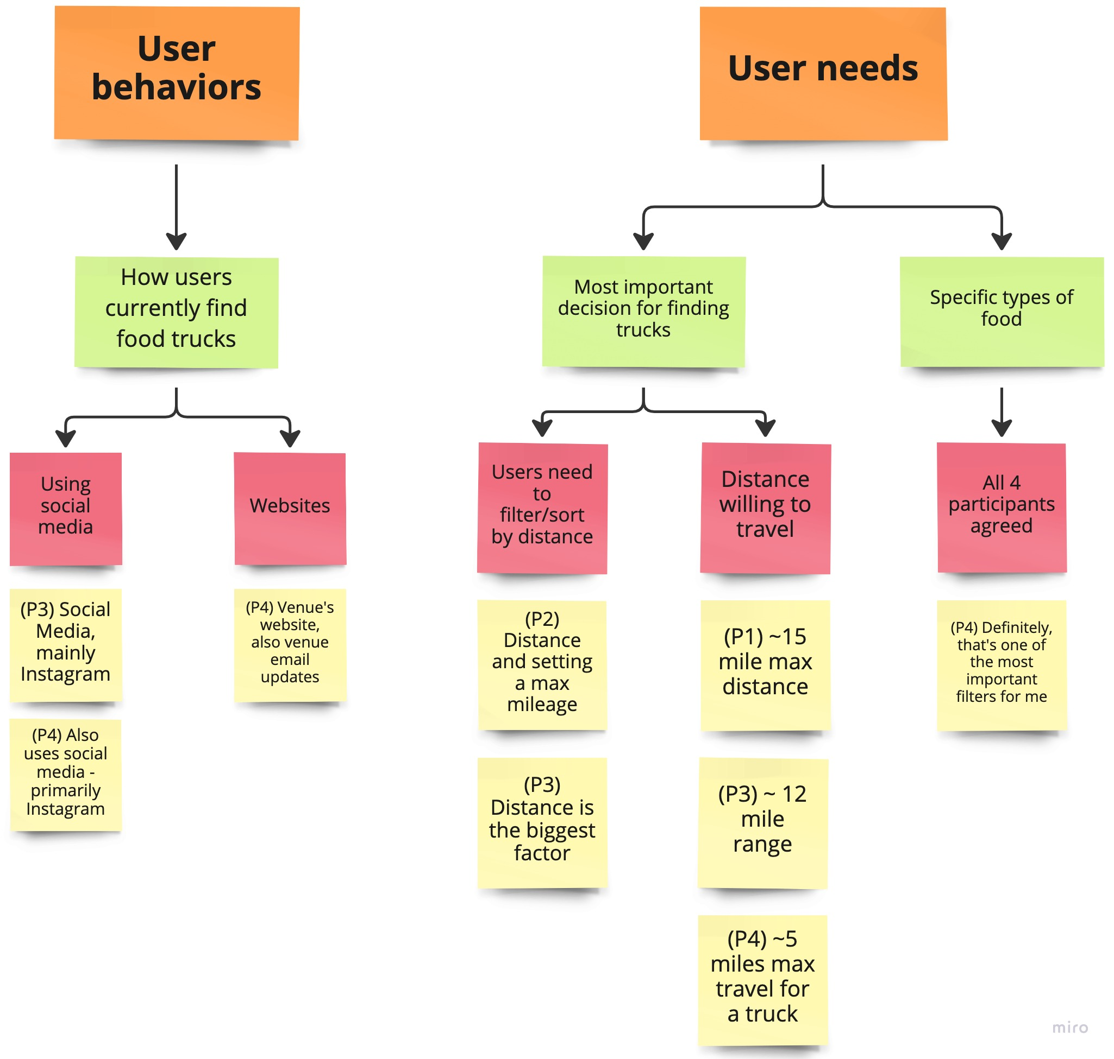
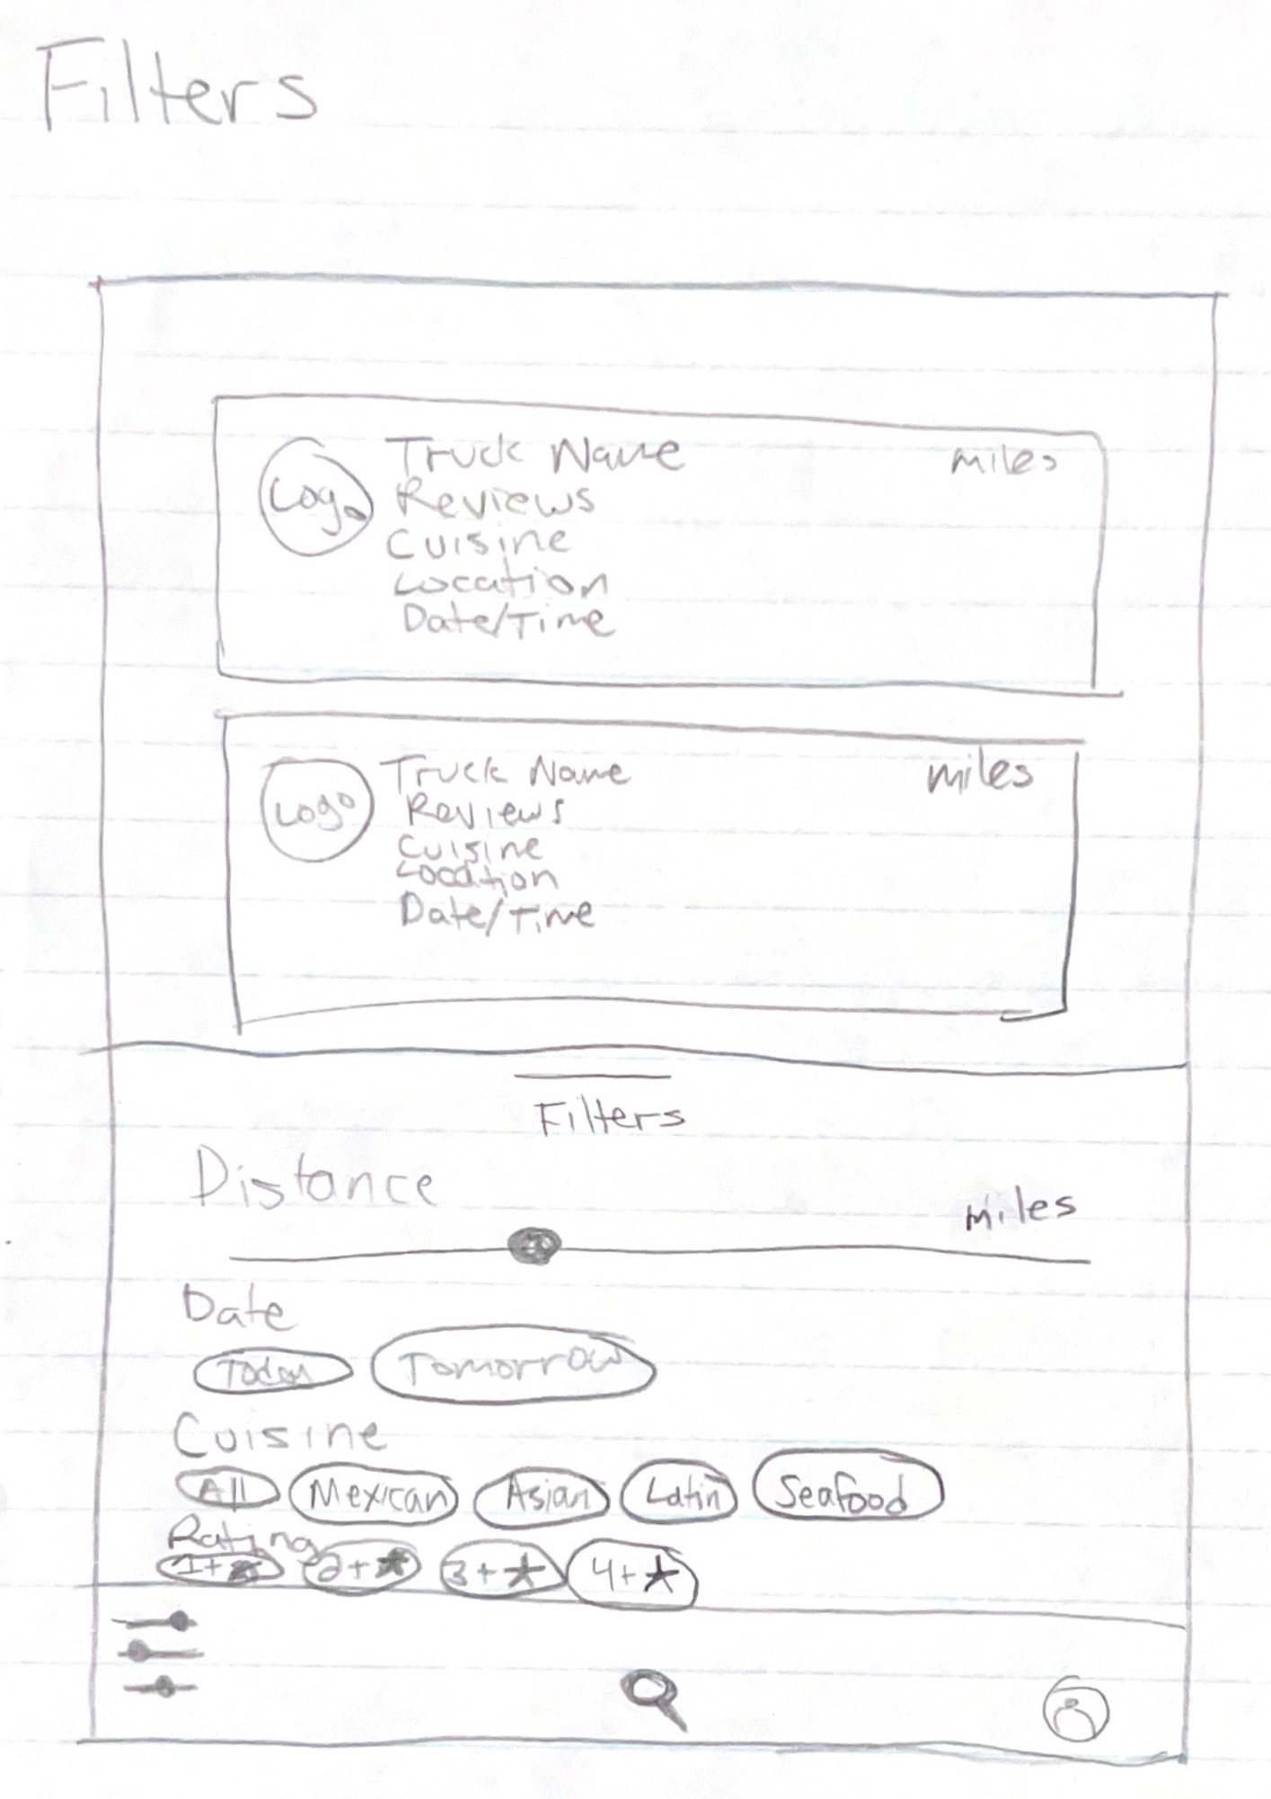
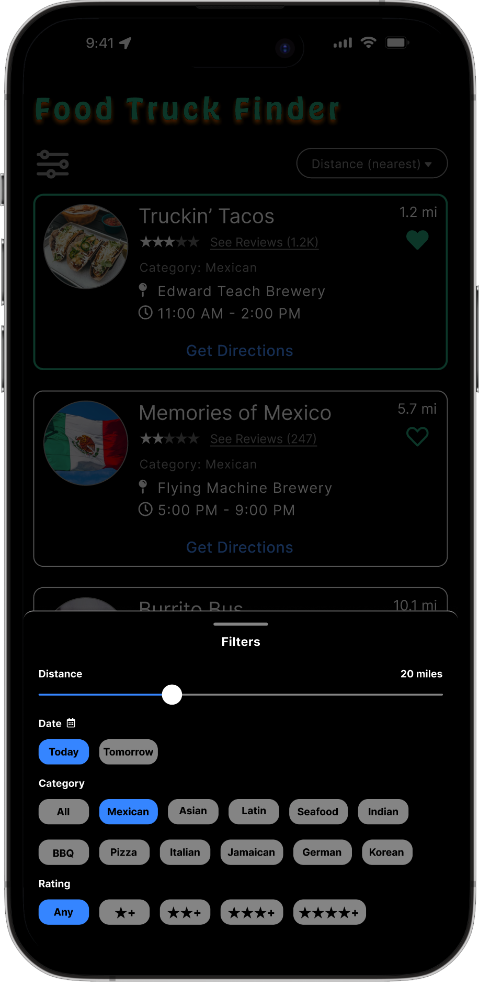
Discovery:
Research & Analysis
I discovered that users liked having the dark background with light colored fonts for contrast, making it easy to read. After the user survey’s, I was able to put together a list of filters they would find beneficial.
Removing elements from certain areas reduced clutter and made for a cleaner UI and less confusion when first looking at the screen.

Slide 5
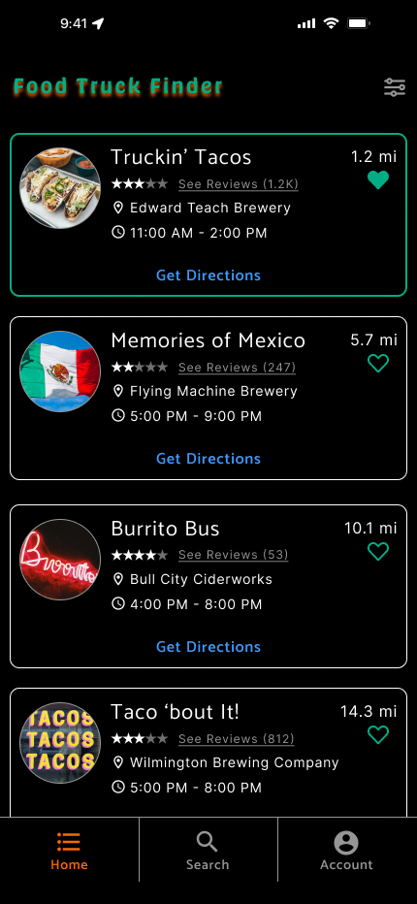
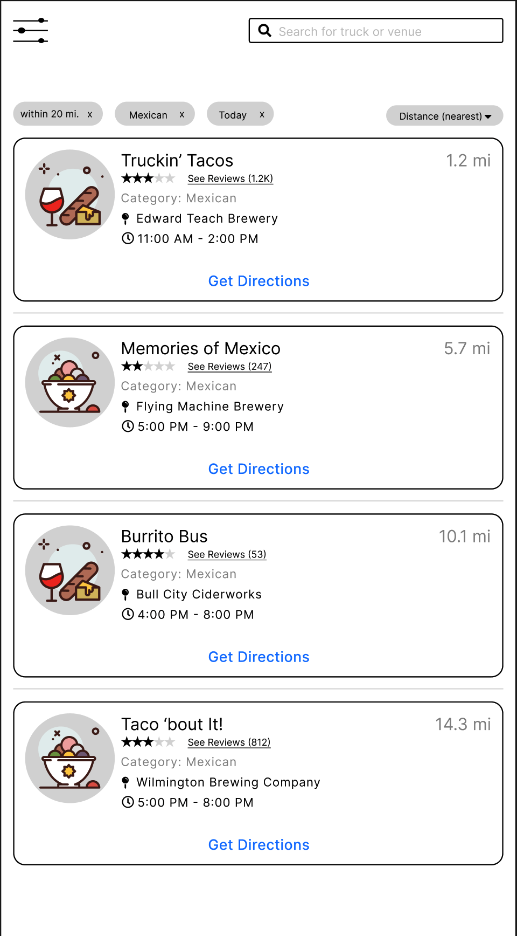
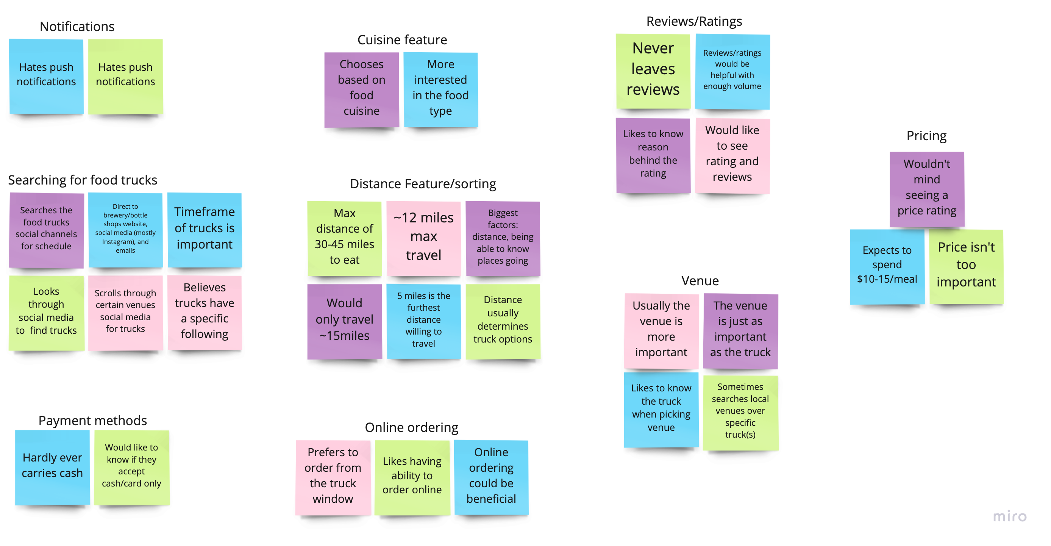
Design: Concepts & Sketching
Using surveys and interviews to learn which features the users will find most beneficial within the app, I was able to start with a basic design to encompass their needs. The key factor for users when finding a food truck is the distance they would have to travel – the closer the truck, the better.
Without overloading and cluttering the cards with too much information, I chose to show only the factors that participants mentioned throughout the studies.

Slide 6
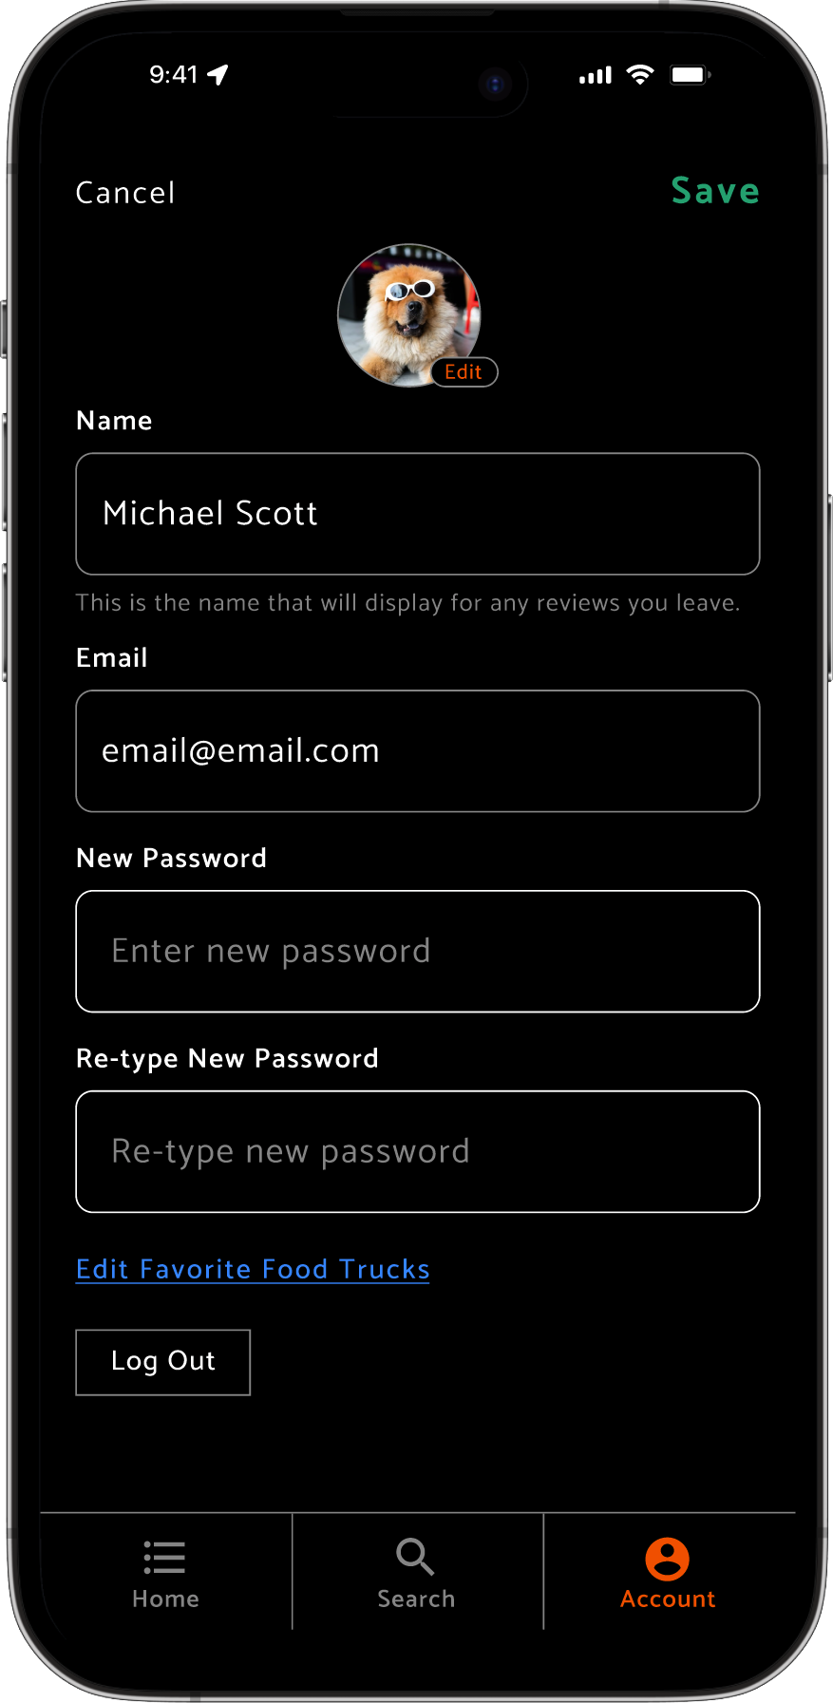
Develop: Prototyping
Using Figma, I created a clickable prototype that was sent to users during the usability test. Creating an easy and clean UI helps the users to navigate around each screen.
Try the Figma Prototype

Slide 7
Test: Validation, Usability, Feedback
After going through the usability tests, a user said the app was “user friendly. It was simple, which was good.”. However, every user had an issue closing the filters overlay.
As you can see from the clip on the right, the filter screen is now extremely clear on the options you can choose and how to close out of the filter's menu.
100%
75%
25%
25%

Slide 8
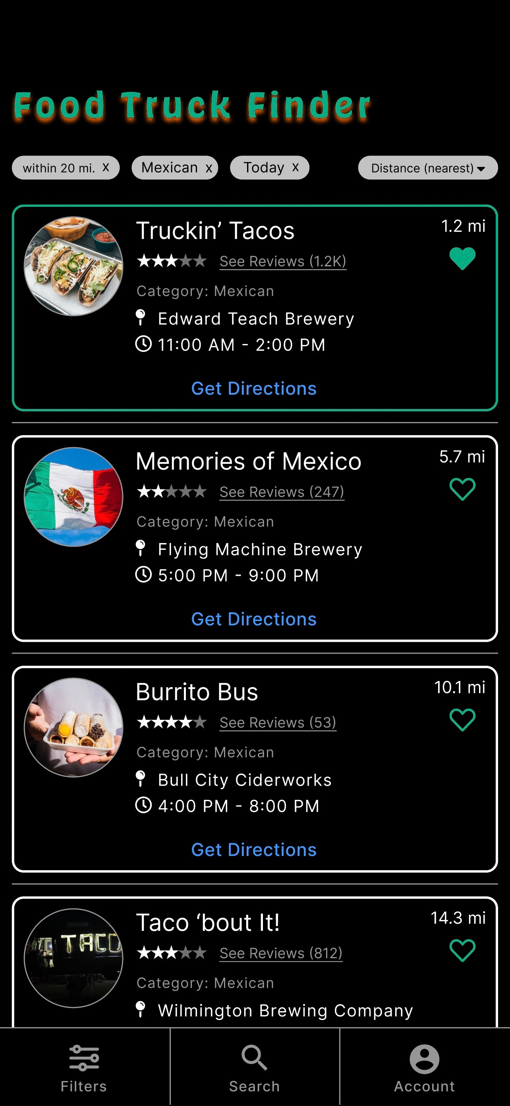
Design: Iteration
After fixing the filters overlay, I addressed the location of the Filters button. I removed the “selected filters” from above the cards (a few users mentioned they were out difficult to read) and replaced it with the Filters button. I also brought the white card stroke down from 2px to 1px, as well as removing the horizontal lines between cards. That should make a cleaner UI with extra available space.

Slide 9
Solution & Impact Overview
Throughout the entire process, the biggest thing I have learned was during the usability study. To me, the exiting the filters overlay was a very easy task, but not one tester tried clicking outside of it after several attempts at swiping it down. This proves that not everything that seems easy to the designer is easy for the end user.

